Slide 1

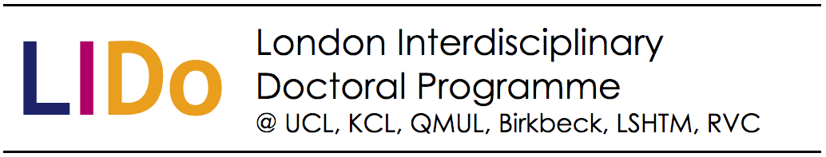
Zoonotic infectious diseases: a “One Health” approach
Infectious diseases in resource poor settings
David Simons
email: dsimons19@rvc.ac.uk
twitter: @David_Simons_UK

Slide 2
Objectives
Introduce the concept of “One Health”
Define zoonotic infectious diseases
Introduce the biological and ecological processes driving disease spillover events
Highlight the role of “One Health” in reducing the risk of and response to spillovers of zoonotic infectious diseases

Slide 3
Global Health, One Health and Planetary Health
Global health has no true consensus definition.
One health is a collaborative, multisectorial approach working across different geographic scales to optimize health outcomes. Recognising the interconnection between people, animals, plants and their shared environment
Planetary health is the health of human civilization and the state of the natural systems on which it depends

Slide 4
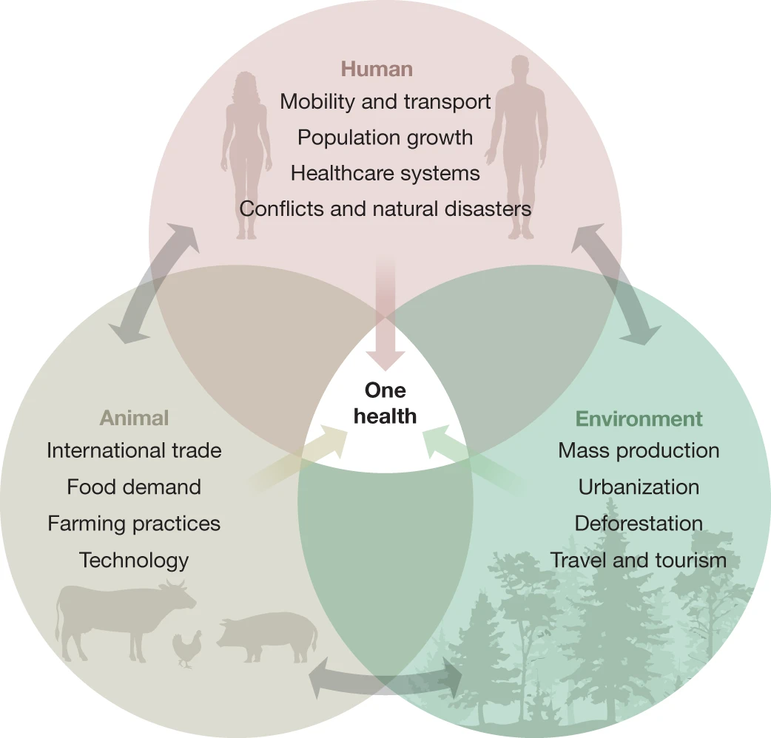

Slide 5
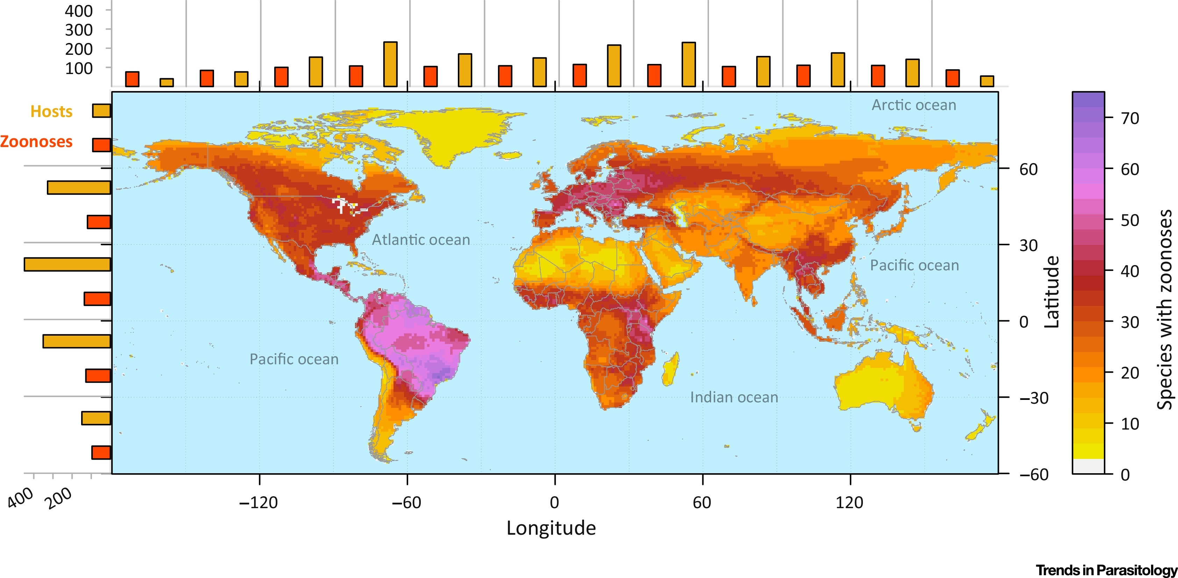
Where are the zoonoses?
Han, B. et al. 2016. Trends in Parasitology

Slide 6
Zoonotic infectious diseases
What human pathogens come to mind as zoonotic diseases?
Notes:
¾ of emerging pathogens are zoonotic.

Slide 7

Some zoonotic pathogens
Viral
Influenza A
Hantavirus
Orf
Rabies
CCHF
Ebola
Lassa
MERS
Monkeypox
Nipah
SARS
COVID-19
WNV
Bacterial
Anthrax
Campylobacter
Bartenellosis
HUS
Leptospirosis
Borellia burgdorferi (Lyme)
Q fever
Brucellosis
Plague
Parasitic
Cysticercosis
Cryptosporiosis
Giardia
Hydatid disease
Ringworm
Toxoplasmosis
Plasmodium knowlesi
Trypanosomiasis
Schistosomiasis

Slide 8
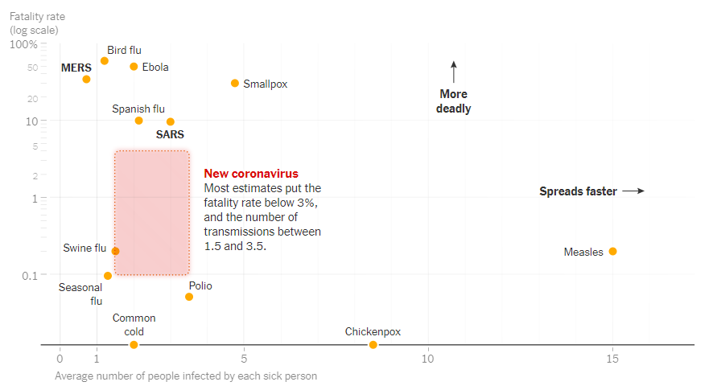
Infectious disease dynamics primer
R₀ - The number of secondary infections after introduction to a fully susceptible population
β – The force of infection, or the rate at which susceptible individuals become infectious
New York Times, 2020.

Slide 9
Spillover events
What are they?
Why are they important?
How do they happen?
Can we avert them?
Questions? sli.do #Q689

Slide 10
Spillover – What is it?
A spillover event is the transmission of a pathogen from its reservoir host into a non-reservoir host
Spillover into non-human hosts can be seen in Nipah & WNV leading to amplification
Spillover into humans can lead to infection and disease e.g. Lassa, P. knowlesi which does not spread much further
Spillover into humans can lead to sustained human-to-human infection e.g. HIV, Ebola, COVID-19

Slide 11
Spillover – Why is it important?
Trypanosomiasis – large parts of Eastern and Southern Africa were historically uninhabited despite being incredibly fertile.
Three specific case studies
HIV
Ebola virus disease
SARS-CoV-2

Slide 12
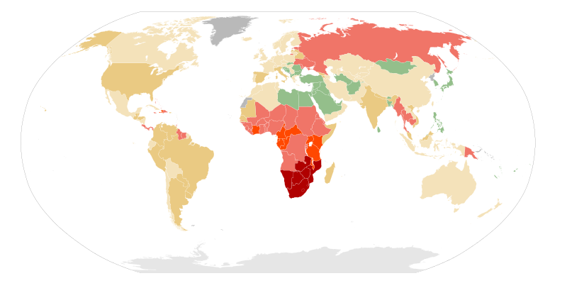
HIV
Wikipedia 2020. HIV prevalence map
Closely related to SIV – likely origin
Evidence of local infection and transmission in DRC prior to the 1960’s
Infection was already widespread before patients in the US and high-income countries were diagnosed with AIDS
Has become a disease of humans, no further spillovers from reservoir populations
What are the factors of this disease that enabled this?
Notes:
Run quiz

Slide 13
Factors supporting HIV spread
Indolent virus – following seroconversion may be asymptomatic for many years despite significant viral load
Seroconversion is relatively short, patients may not present during this time or investigations may not be conducted
Long infectious period – individuals may spread the disease for many years
Mode of transmission – relatively high frequency event (sexual) and low frequency but important effective events (blood-borne, childbirth)
RNA virus – high mutation rate
Globalisation
Marginalised populations

Slide 14
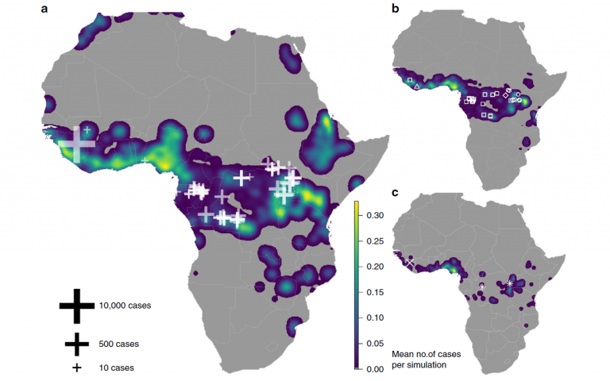
Ebola virus disease
Redding et al. 2019. Nature communications
Several similar flaviviruses incl. Marburg
Reservoir is believed to be bat spp.
Events lead to high mortality epidemics, historically low numbers of infected individuals
Epidemics are localised to Western and Central Africa
High burden on healthcare infrastructure
Important human-to-human transmission
What are the factors that support Ebola transmission?
Notes:
Run quiz

Slide 15
Factors supporting Ebola spread
Human-to-human transmission is in bodily fluids
Burial practices increased risk of disease transmission
Poor healthcare infrastructure increased nosocomial spread
Poor IPC strategies
Conflict and community resistance to outside actors
Limited information dissemination

Slide 16
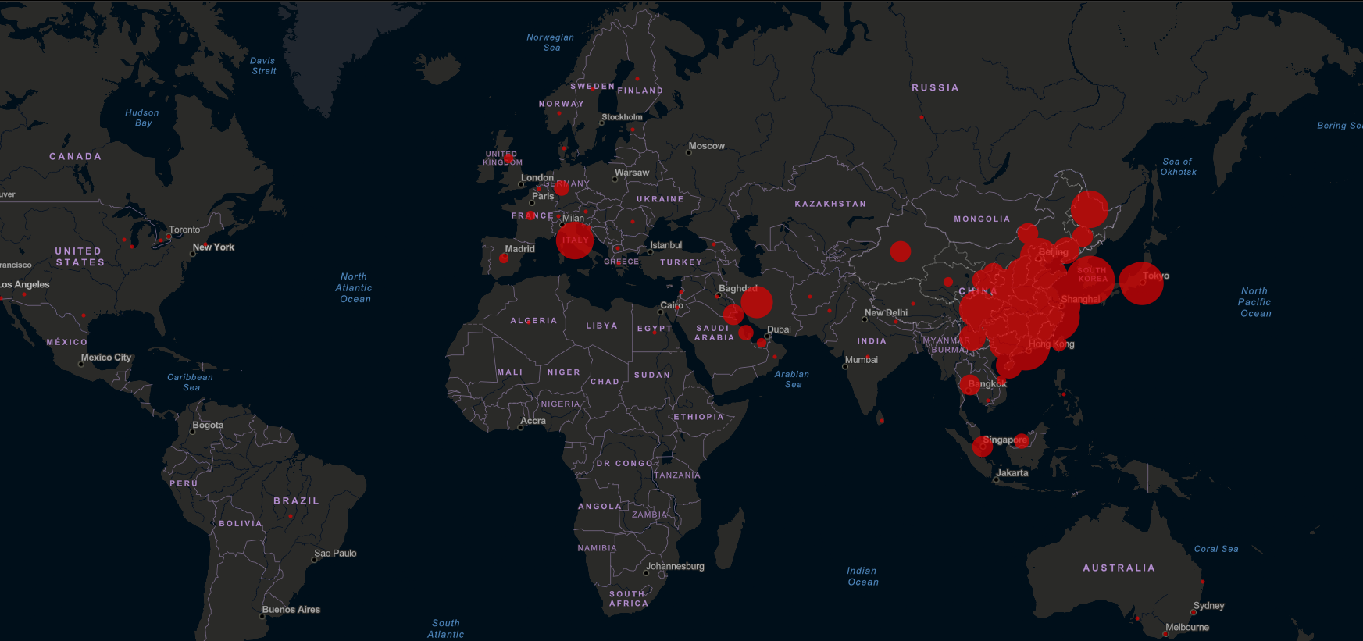
SARS-CoV-2
Johns Hopkins University, Coronavirus map. 2020
Coronavirus’s cause 20% of human colds (not all are zoonotic, ?historical spillover)
SARS & MERS are further zoonotic examples
This disease likely emerged from a “Wet Market”
Similar to SARS likely bat spp. reservoir
Expected that there is an amplifying species, current viral sequences suggest Pangolins
What we are seeing now is human-to-human transmission

Slide 17
Factors supporting SARS-CoV-2 spread
Aerosol or droplet spread in respiratory secretions
High proportion of asymptomatic or sub-clinical cases
Increased globalisation and transport infrastructure
High density population centres
Long incubation periods

Slide 18
Spillover – How do they happen?
Proximal and distal factors
Proximal include:
Airborne – Nipah & SARS-CoV-2
Contamination – Lassa
Vector borne – P. knowlesi
Consumption (livestock) – Cysticercosis
Consumption (opportunistic) – HIV & Ebola
Wound/Saliva – Rabies
Distal will be discussed further

Slide 19
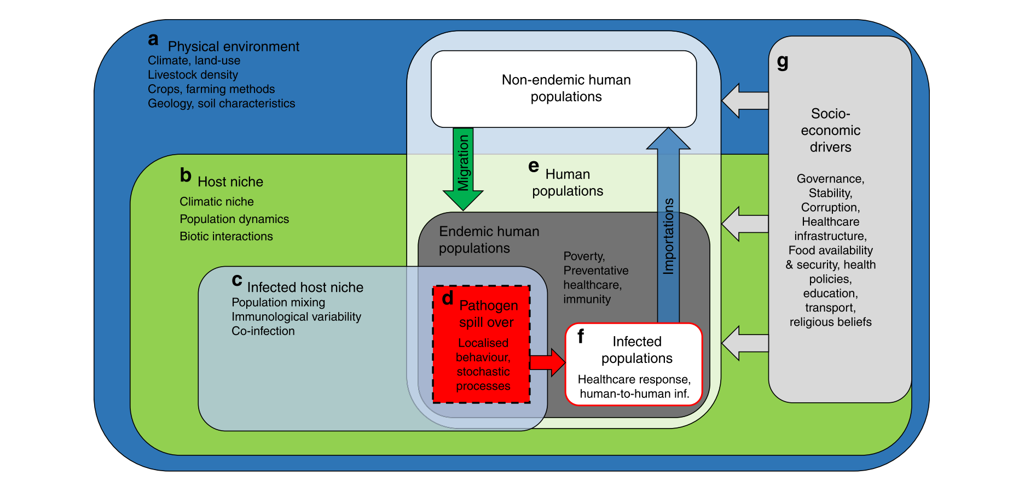
A systems dynamic approach
Redding et al. 2019. Nature communications

Slide 20
The physical environment
Climate
Land use
Livestock density
Crops and farming methods
Geology and soil characteristics
Questions? sli.do #Q689
Notes:
Climate – dengue, changes in climate can lead to the conditions, for example increased rainfall that are suitable for the mosquitos that can act as vectors for certain arboviruses
Land use – P. knowlesi, increasing fractured forests can bring animal reservoir populations into contact with human habitation increasing the risk of this form of malaria
Livestock – WNV, peridomestic livestock can act as amplifiers for pathogens
Crops and farming – Lassa, rodents, particularly commensal rodents will change in abundance based on crop cycling and harvesting
Geology – Leptospirosis, increased flooding or standing water can provide a greater number of locations for these pathogens to reside

Slide 21
A systems dynamic approach

Slide 22
Host niche
Climatic niche
Population dynamics
Biotic interactions
Notes:
Climatic niche, this is more related to expanding niche’s, or changing distributions based on climate conditions. For example mosquitos and altitude, expanding latitude.
Population dynamics, for example Lassa and Lyme, changes in the reservoir population as part of natural cycles.
Biotic interactions describe conditions in which different biological processes can interact to increase or decrease risk

Slide 23
A systems dynamic approach

Slide 24
Infected host niche
Population mixing
Immunological variability
Co-infection
Notes:
Population mixing – diseases don’t spread homogeneously.
Immunological variability – some evidence that bats are better able to handle their circulating viruses. Ebola for example is lethal to both great apes and humans but may be well tolerated in bat populations. Nipah is the same
Co-infection – this is important for influenza viruses that undergo recombination

Slide 25
A systems dynamic approach

Slide 26
Pathogen Spillover
Localised behaviour
Stochastic processes
Notes:
Localised behaviour – certain behaviours by animals or humans may increase the risk of disease. Nipah palm wine. Ebola bush meat.
Stochastic – is effectively randomness

Slide 27
A systems dynamic approach

Slide 28
Socioeconomic drivers
Governance
Stability
Corruption
Healthcare infrastructure
Food availability and security
Health policies
Education
Transport
Religious beliefs

Slide 29
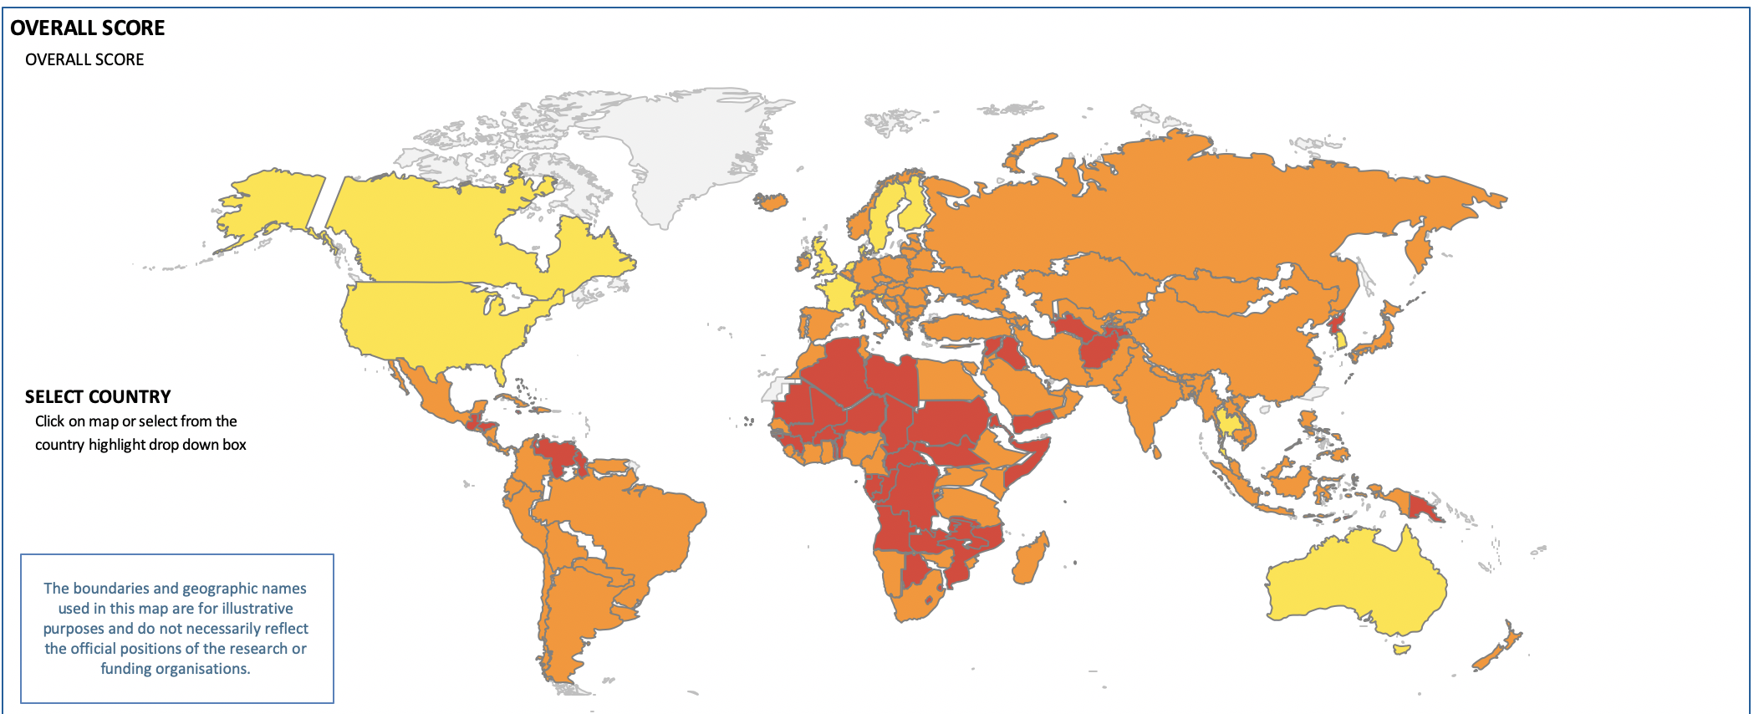
Global Health Security Index: 2019
Notes:
Measures ability to prevent, detect, respond, healthcare provision, compliance with international norms, risk environment
30% of countries demonstrate a one health approach to zoonotic disease surveillance
Just over half of countries have animal health professionals included in their epidemiology training programs
62% of countries haven’t submitted an incidence for zoonotic diseases to the world organisation of animal health

Slide 30
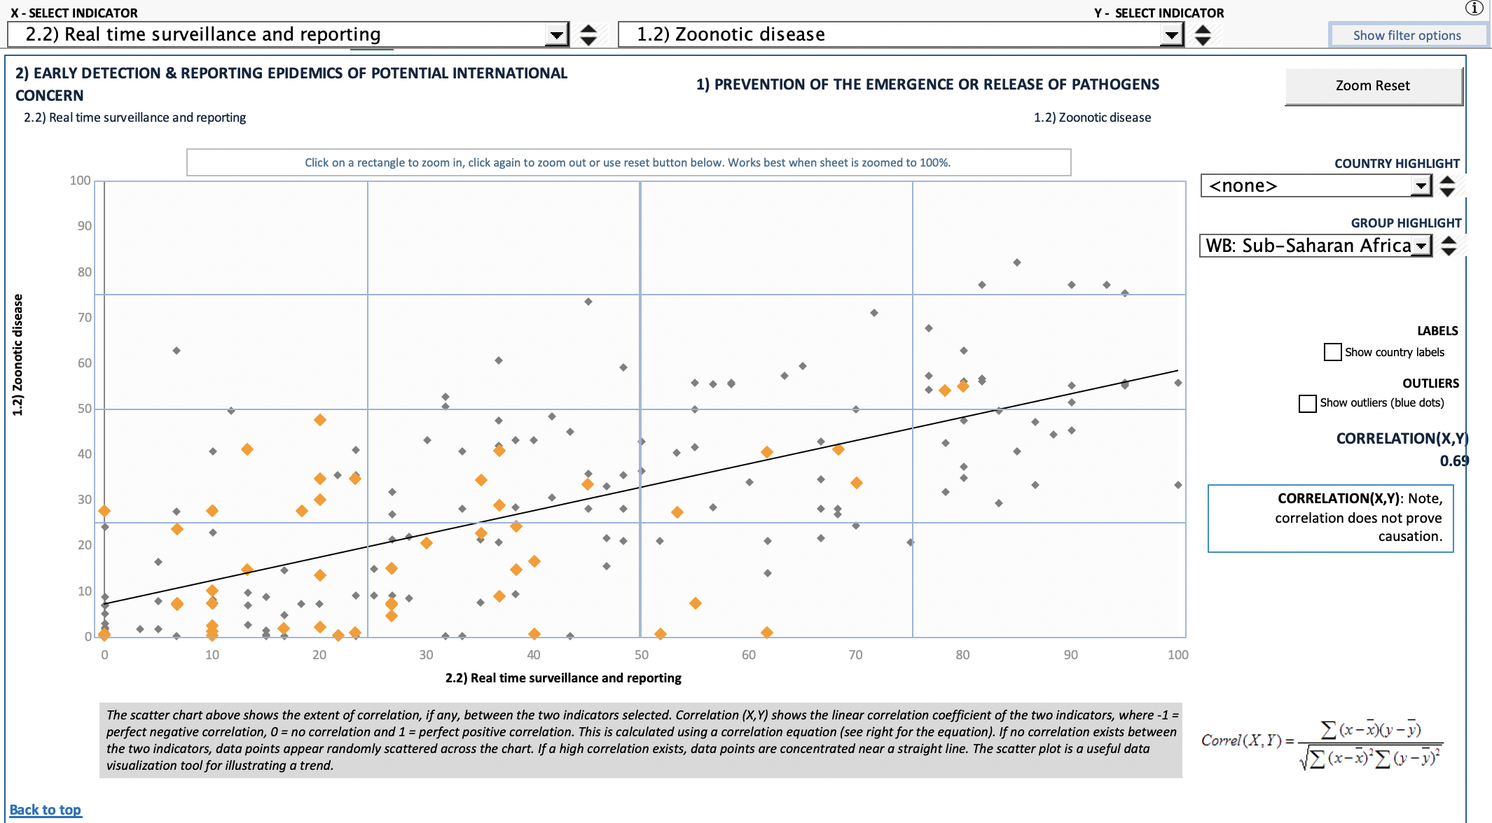
Notes:
High scores represent effective measures and systems in place to prevent zoonotic disease emergence. High scores represent effective surveillance and reporting of epidemics.

Slide 31
A systems dynamic approach

Slide 32
Infected populations within endemic and non-endemic populations
Healthcare response
Human-to-human infection
Poverty
Preventative healthcare
Immunity
Pathogen transmission through importation and migration
Notes:
Two drivers of zoonotic infectious diseases that benefit from a one-health approach are biodiversity and climate change. I’ll discuss these two in further detail.

Slide 33
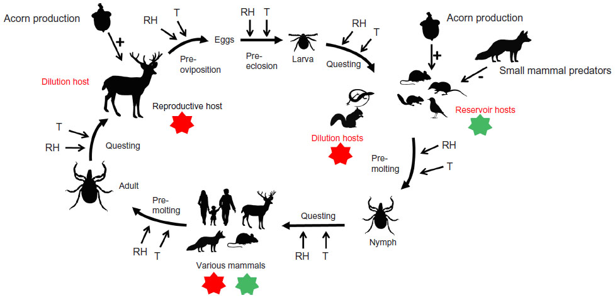
Biodiversity and zoonoses
Pfaffle, M. et al. 2015. Research and Reports in Biodiversity Studies
Notes:
The start of tick activity, questing duration, and interstadial development (pre-oviposition, pre-eclosion, pre-molting) depend on the ambient temperature and relative humidity, which influence water loss, the total generation time, and the proportion of ticks that die before reproduction.47 Host densities of the most important hosts of I. scapularis, deer, and mice are influenced by mast years and predator densities. Transovarial transmission of Borrelia spirochetes is rare; main transmission routes are transstadial and by feeding on an infected host. The main host of adult ticks is white-tailed deer which acts as a dilution host for Borrelia burgdorferi sensu lato but as a reproductive host for the tick population. Larvae feed on a variety of smaller hosts that act either as reservoir hosts for B. burgdorferi s.l. (mice, shrews, chipmunks) or as dilution hosts (lizards, squirrels). Nymphs feed on various mammals, including humans, which can act as dilution or reservoir hosts.38,118 Host descriptions in red refer to their importance for the pathogen, and host descriptions in black to their importance for the tick population. Red stars: no infection takes place; green stars: ticks can get infected with spirochetes. Arrows with a plus sign show a positive influence, and arrows with a minus sign a negative influence.

Slide 34
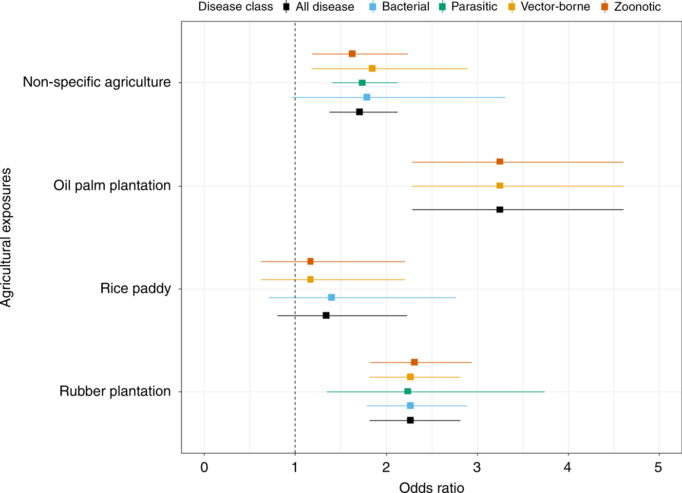
The role of land use change
Shah, H. A. et al. 2019. Nature Communications
Notes:
Agricultural land-uses consistently exacerbate infectious disease risks in Southeast Asia
esults strongly suggest that exposure to agricultural land-use either occupationally or residentially is consistently associated with increased infectious disease risk (average 74% increase)

Slide 35
Conclusions and summary
Zoonotic diseases are widespread.
Spillover events into human populations are inevitable
One health provides a framework to reduce this risk and develop strategies to prepare and prevent these events
The systems in which these events occur are complex and act across vast scales
Special attention has been payed to the role of anthropogenic changes to biodiversity and land use and the effect on zoonotic disease emergence

Slide 36
References
One health and Planetary health
Cunningham A., Daszak P. and Woods J. 2017. One health, emerging infectious diseases and wildlife: two decades of progress? Phil. Trans. R. Soc. B. 372
Editorial, 2019. The bigger picture of planetary health. Lancet Planetary Health
Zoonotic infectious diseases
Jones K. et al. 2008. Global trends in emerging infectious diseases. Nature
W. Karesh, et al. 2012. Ecology of zoonoses: Natural and unnatural histories. The Lancet.
Han. B., Kramer, A. M., Drake, J. M. 2016. Global patterns of Zoonotic disease in mammals. Trends in Parasitology
Infectious disease dynamics
Bjornstad O. N., et al. 2002. Dynamics of measles epidemics: Estimating scaling of transmission rates using a time series SIR model. Ecological monographs.
Spillover
Quammen D. 2012. Spillover
Lo Iacona, G. et al. 2016. A unified framework for the infection dynamics of zoonotic spillover and spread. PLoS Neglected Tropical Diseases
Systems dynamic approaches to zoonotic disease
Redding. D. W., 2019. Impacts of environmental and socio-economic factors on emergence and epidemic potential of Ebola in Africa. Nature communications
Global health security index
Global Health Security Index 2019
Biodiversity, land use and disease risk
Ostfeld R. 2017. Biodiversity loss and the ecology of infectious diseases. Lancet Planetary Health
Pfaffle M., Littwin N., Petney T. N. 2015. The relationship between biodiversity and disease transmission risk. Research and Reports in Biodiversity Studies
Brock P. et al. 2019. Predictive analysis across spatial scales links zoonotic malaria to deforestation. Proceedings of the Royal Society B: Biological Sciences
Shah H. A. et al. 2019. Agricultural land-uses consistently exacerbate infectious disease risks in Southeast Asia. Nature Communications
Climate change and disease risk
Estrada-Pena A., et al. 2014. Effects of environmental change on zoonotic disease risk: an ecological primer. Trends in Parasitology

